Slide 1





From Genes to Populations:
The Intelligent Data Analysis of
Biological Data
Allan Tucker
School of Information Systems Computing and Mathematics, Brunel University, London. UB8 3PH. UK
Moorfields Eye Hospital

Slide 2
The Data Explosion
“We are drowning in information,
but starving for knowledge” John Naisbett
  Advance of IT and the Internet
  Massive increase in ability to:
    Record: Electronic records and forms
    Store: Data Warehouses
    Analyse: Data Mining and Visualisation
  Risk of Information Overload

Slide 3
Intelligent Data Analysis
IDA attempts to deal with data explosion to discover patterns and knowledge from data
Typical analysis tasks:
  Clustering
  Classification
  Feature Selection
  Prediction and Forecasting

Slide 4
Overlap with Statistics
“Statistics is the art to collect, to display, to analyze, and to interpret data in order to gain new knowledge.” Sachs 1999
“... statistics, that is, the mathematical treatment of reality ...” Hannah Arendt
“There are lies, damned lies, and statistics.”
Benjamin Disraeli

Slide 5
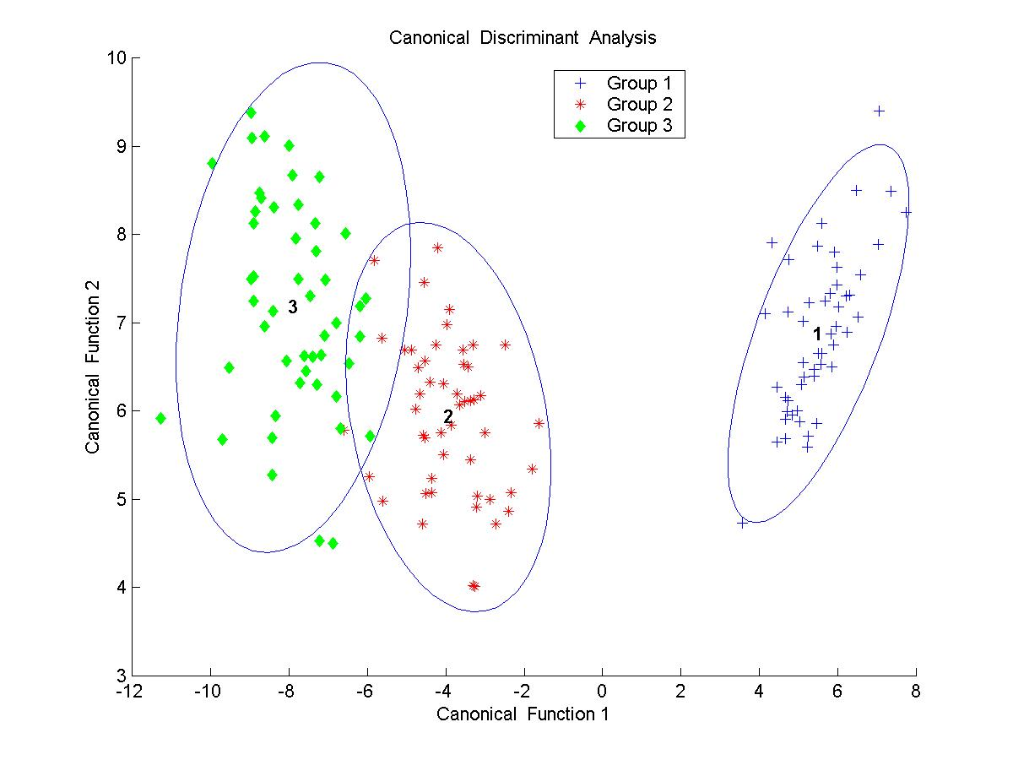
Clustering (unsupervised learning)

Slide 6
Classification (supervised learning)

Slide 7
Feature Selection
Scatterplots from different features of the same dataset

Slide 8
Bayesian Networks
An IDA method to model a domain using probabilities
Easily interpreted by non-statisticians
Can be used to combine existing knowledge with data
Essentially use independence assumptions to model the joint distribution of a domain

Slide 9
Bayesian Networks
Simple 2 variable Joint Distribution
Can use it to ask many useful questions
But requires k^{N} probabilities
P(Gene, Disease)
Gene ¬ Gene
Disease 0.89 0.01
¬ Disease 0.03 0.07

Slide 10
Bayesian Network for Toy Domain
Gene A
Gene B
P(A)
P(B)
.001
.002
A B P(C)
T T .95
T F .94
Gene C
F T .29
F F .001
C P(D)
C P(E)
T .70
T .90
F .01
F .05
Gene D
Gene E

Slide 11
Bayesian Networks
Use algorithms to learn structure and parameters from data
Or build by hand (priors)
Also continuous nodes (density functions)

Slide 12
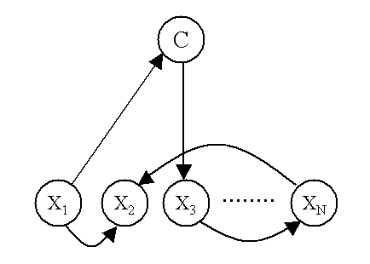
Bayesian Networks for Classification & Feature Selection
Node that represents the class label attached to the data

Slide 13
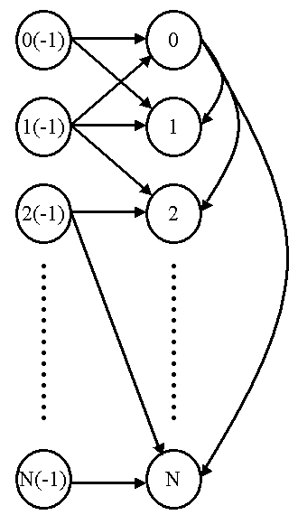
Dynamic Bayesian Networks for Forecasting
Nodes represent variables at distinct time slices
Links between nodes over time
Can be used to forecast into the future

Slide 14
Biological Data
Microbiology (bioinformatics):
  Genes, parallel sequencing
Biological / Clinical (systems biology, medical informatics):
  Cell Models, Clinical Tests
Population (Ecoinformatics?) :
  Data from species: biomass etc.

Slide 15
Some of our projects in
Genes: UCL & Leiden University
  Identifying Genes relevant to conditions (MD)
  Identifying Genes common across organisms
Biological & Clinical: Brunel & Moorfields
  Modelling vesicles within cells for controlling osteoblasts
  Develop model to forecast early glaucoma based on differing clinical tests
Population: Kew & DFO, Canada
  Identifying ideal germination conditions for seeds
  Identifying key species in different oceans

Slide 16
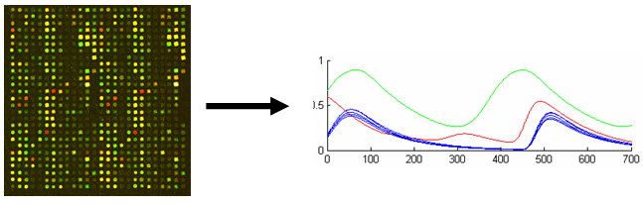
1 Microarray Data

Slide 17
Microarray Data
Major source of data for gene expression activity
Technology takes measurements over 1000s of genes simultaneously
Gene Regulatory Networks (GRNs) model how genes interact
Eliciting reliable GRNs from data key to understanding biological mechanisms

Slide 18
Aims
Reliability issues that surround microarray gene expression data
Can we build GRN models that have enhanced performance, based on a richer and/or broader collection of data than a single microarray dataset?

Slide 19
Aims
Three main threads of research:
  Text-based knowledge from the body of scientific literature integrated into the reverse-engineering process as prior knowledge for Bayesian network models to improve resulting GRN models
  Take advantage of multiple publicly available microarray gene expression datasets that have been generated in similar biological studies
  Expand this idea to explore biological mechanisms that are consistent between different biological models with increasing complexity (and between different species)

Slide 20
a) Literature-based priors for gene regulatory networks
Literature Prior calculated from profiles which are generated using software that converts the number of times two concepts are discussed within publications
Convert it to a Prior Probability = correlation falling within a 2 tailed confidence interval
Incorporated into scoring metric when learning networks
(2008) Jelier R, et al. Literature-based concept profiles for gene annotation: The issue of weighting. Int. J. Med. Inform.; 77:354-362.
(2009) Steele, E., Tucker, A., 't Hoen, P.A.C. and Schuemie, M.J., Literature-Based Priors for Gene Regulatory Networks, Bioinformatics 25 (14) : 1768-1774

Slide 21
Experiments
Learn Bayesian networks from data
Given known biological structures, test using ROC analysis:
  True Positives: links that are correctly id
  False positives: links that are incorrectly id
  False Negatives: links that are missed
  True Negatives: links that are correctly missed

Slide 22
Yeast and E-Coli
Issues with circularity when validating

Slide 23
b) Consensus Bayesian Networks
Different platforms involve different biases:
e.g. Oligonucleotide estimates of absolute value of expression whereas cDNA measures relative differences between genes.
Previous research established comparing datasets using standard normalisation is difficult and not straightforward
An attempt to combine multiple microarray data sources through post-learning aggregation
Steele, E. Tucker A. “Consensus and Meta-analysis regulatory networks for combining multiple microarray gene expression datasets”, Journal of Biomedical Informatics 41(6), pp 914-926 , 2008

Slide 24
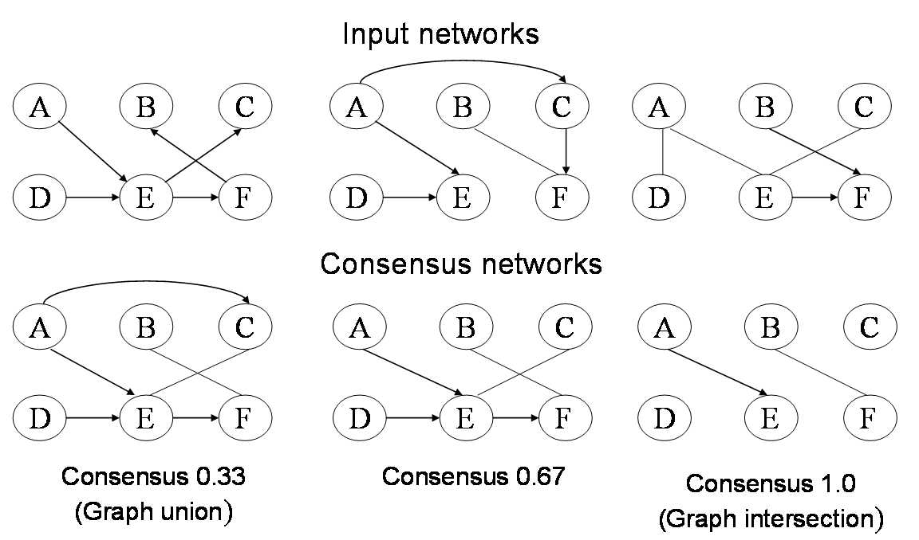
Consensus Bayes Networks

Slide 25
E Coli

Slide 26
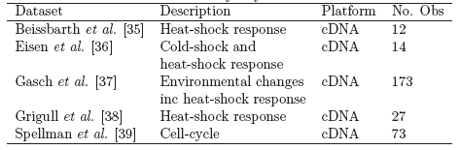
Yeast

Slide 27
How to select best input networks?
Prediction – Train a network on one dataset
  Test it on the others sets (Independent Data)
  As opposed to Cross Validation (testing on the same dataset)

Slide 28
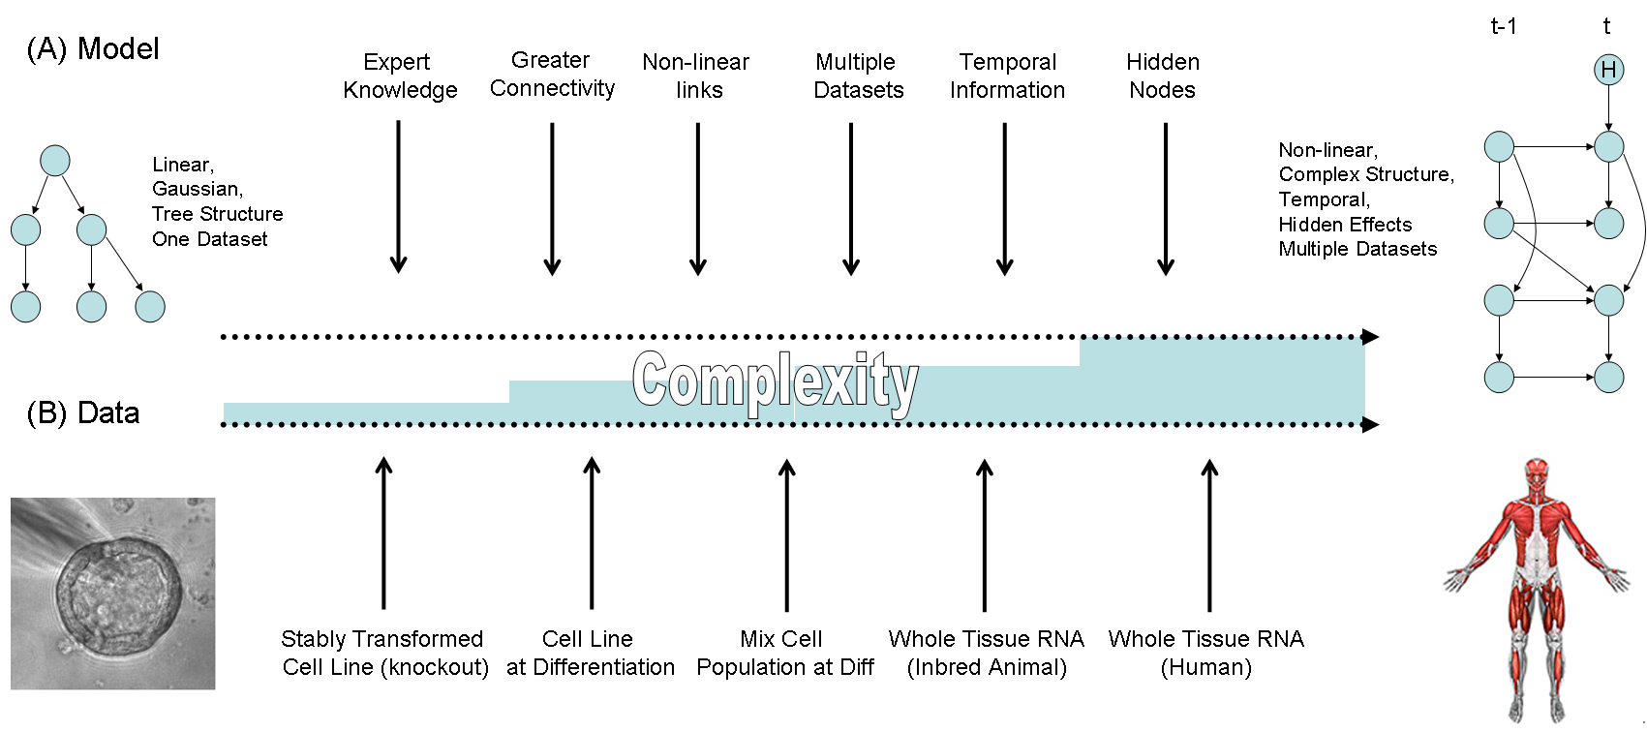
c) Models of Increasing Complexity
Specification of three muscle differentiation datasets
(2010) Anvar, S.Y., t' Hoen, P.A.C. and Tucker, A., The Identification of Informative Genes from Multiple Datasets with Increasing Complexity, BMC Bioinformatics 11 : 32

Slide 29
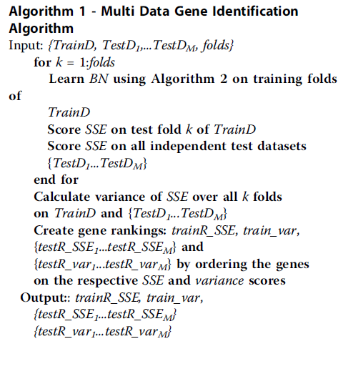
MIC
Select one dataset for training
Others become test sets
Score mean and variance of SSE using CV and indpt test sets
Use these to rank genes

Slide 30
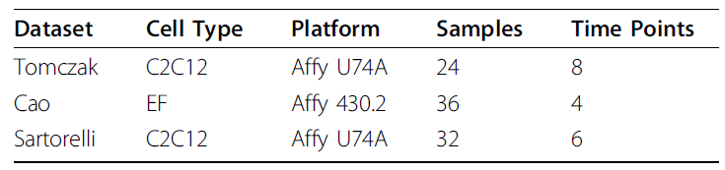
MIC - Datasets
All concerned with the differentiation of cells into the muscle (Myogenic) lineage
In-vitro system mimics the formation of new muscle fibres in-vivo
Cao uses embryonic fibroblasts, others use tumor cell line that has the potential for differentiation into different lineages (mainly muscle and bone)
Cao use MyoD and MyoG to force cell differentiation (others use serum starvation)
Sartorelli includes different treatments that affect timing and efficiency

Slide 31
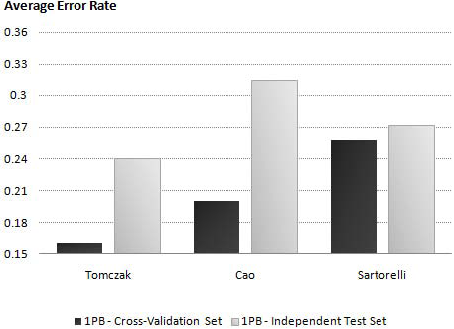
MIC
Select genes using one dataset (black) at a time and compare average CV error rate of BN classifier learnt on same dataset and validated on the other two datasets independently (grey).
Cao does well on CV but overfits
Tomzczak does well on both

Slide 32
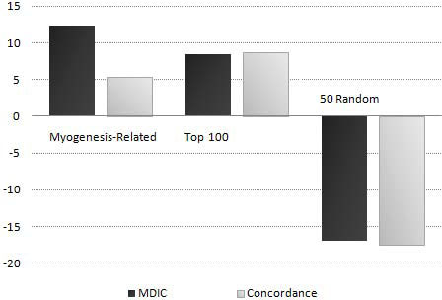
MIC
Select 100 informative (KS test), and 50 uninformative genes.
Train BN classifier on Tomczak and test on Sartorelli.
Rank genes according to average error rate.
Score average improvement or deterioration of Myogenesis-Related, Top 100 and 50 random selected genes in Sartorelli
Compare our method with
rankings generated by
concordance model.

Slide 33
MIC Conclusions
Predictive and consistent genes across independent
datasets are more likely to be fundamentally involved
in the biological process under study
Results imply that gene regulatory networks identified
in simpler systems can be used to model more complex
biological systems

Slide 34
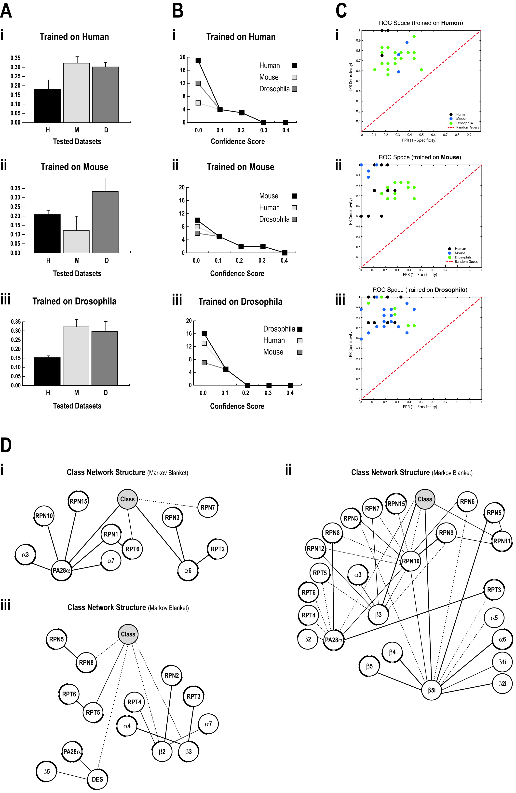
Inter-species Mechanisms

Slide 35
Inter-species Mechanisms

Slide 36
2 Medical Data

Slide 37
Eye Disease: VF and HRT Data
Progressive loss of the field of vision is characteristic of many eye diseases
Glaucoma is a leading cause of irreversible blindness in the world.
  VF Data: sensitivity of field of vision
  HRT Data: anatomical info of retina

Slide 38
a) Classification of Early Glaucoma
Expert Knowledge
Clinical Decision based on VF Tests
Clinical Decision based on HRT Image Tests
Can we combine these to improve the detection of the early onset of glaucoma?
(2010) Ceccon, S., Garway-Heath, D., Crabb, D. and Tucker, A., Investigations of Clinical Metrics and Anatomical Expertise with Bayesian Network Models for Classification in Early Glaucoma, Workshop on Supervised and Unsupervised Ensemble Methods and Their Applications (SUEMA 2010), held at the European Conference on Machine Learning and Principles and Practice of Knowledge Discovery in Databases (ECML/PKDD 2010)

Slide 39
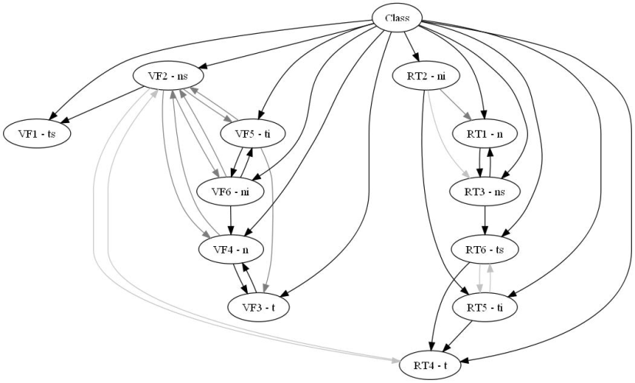
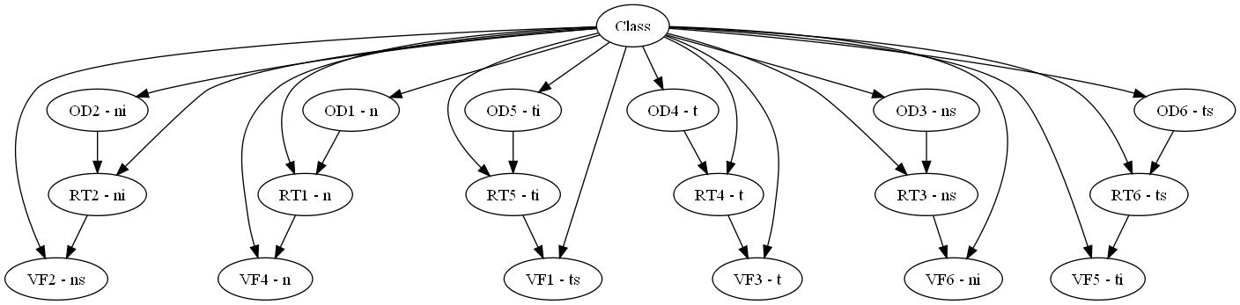
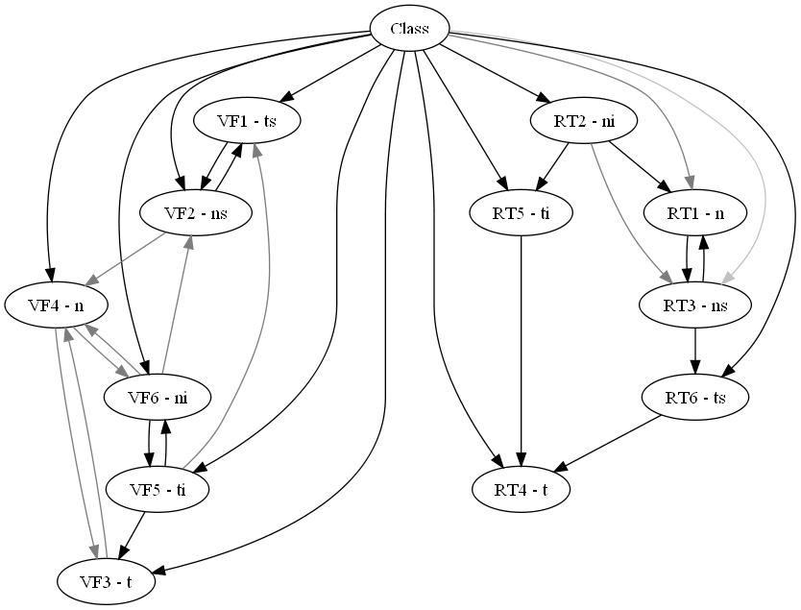
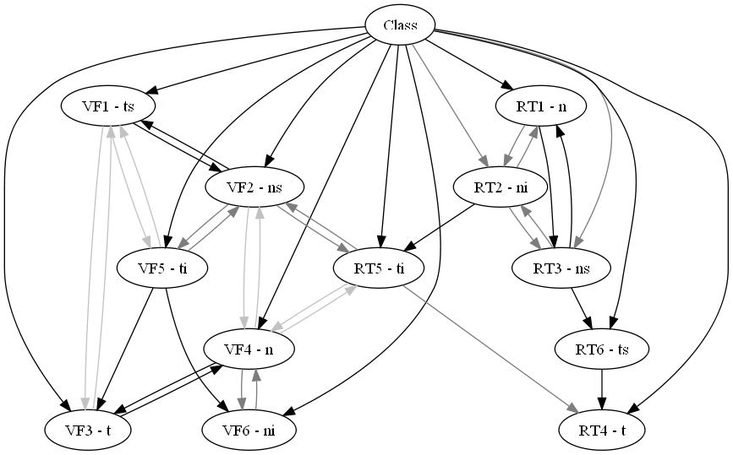
BN Classification of Early Glaucoma
1) Learnt from Control Data only
2) Built from Anatomical Knowledge
3) Learnt based on MRA HRT Test
4) Learnt based on AGIS VF Test

Slide 40
BN Classification of Early Glaucoma
Different networks capture different features (AGIS vs MRA)
Anatomy network is better in finding converters
Control-based network is better in finding controls

Slide 41
Modelling Clinical Data
Biomedical studies often involve data sampled from a cross-section of a population
  Collecting medical information on patients suffering from a particular disease and controls
These studies show a “snapshot” of the disease process but disease is inherently temporal:
  Previously healthy people can develop a disease over time going through different stages of severity
If we want to model the development of such processes, usually require longitudinal data (expensive)

Slide 42
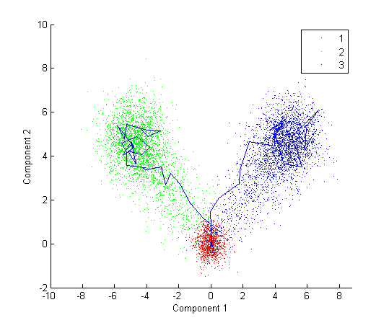
b) Pseudo Time-Series for CS Data
Tucker, A. and Garway-Heath, D., The Pseudo Temporal Bootstrap for Predicting Glaucoma from Cross-Sectional Visual Field Data, IEEE Transactions on IT in Biomedicine 14 (1) : 79-85 , 2010

Slide 43
Pseudo Time-Series Models
Ordering labelled CS data based upon Minimum Spanning Trees & PQ-Trees (Rifkin et al. 2000)
Treat ordered data as “Pseudo Time-Series” to build temporal models (Tucker et al., 2009)
Here we use hidden variables to discover disease states (and transitions) within these pseudo time-series

Slide 44
Discovered State Transitions
Our algorithm unlabels the known healthy / disease states (used to build the Pseudo TS)
Uses EM to relearn an increasing no. of hidden states
The discovered states and their trajectories show:
  Stable healthy state (4)
  Stable disease state (1)
  Glaucoma in HRT only (3)
  Glaucoma in VF only (2)
Severe Disease
Healthy

Slide 45
Applicable to any clinical CS study?
Breast Cancer:
Found key variable with ‘tipping point’

Slide 46
Applicable to any clinical CS study?
Parkinson’s Disease:
Found cluster of controls with mild symptoms

Slide 47
Conclusions
We explore how to build time-series models from cross-sectional data
Here we use a simple incremental approach to discover hidden states and the transitions between them
Demonstrate on glaucoma test data from two different sources
Transitory and stable states are found that relate to known anatomical and clinical expectations

Slide 48
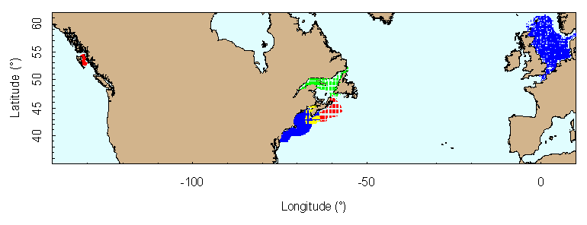
3 Population Data

Slide 49
3 Models of Population
Genetics and disease impact on individual level
But also on the population level
  Spread of disease
  Biological variation amongst a population

Slide 50
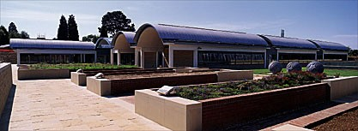
a) The Millennium SeedBank
RBG, Kew banking seeds for 35 years
MSB established for 10 years
152 partner institutions in 54 countries worldwide
Collected and stored >47,000 collections representing >24,000 species

Slide 51
The Problem
Large, growing backlog of data
Optimum germination conditions & simplest to apply – for users
Can we integrate GIS with SB DB?
How best to exploit the data – focus on UK
What methods can solve these problems?
  Feature Selection
  Classification
  Explanation

Slide 52
Results: Classifiers – Performance

Slide 53
Results: Classifiers – Decision Tree

Slide 54
Decision Tree Interpretation
Some subtrees hard to clarify, others generate quite reasonable hypotheses:
  Rainfall and altitude which seems to fit into the rough split of highland and lowland regions
  Cluster of FAILs for Umbill. before middle of August. Interesting to see why these conditions set up wrong in experiments
  Large cluster of FAILs for Cyperaceae at higher annual rainfall in the tree. Need to explore what it is in our applied treatments that is not resulting in successful germination.

Slide 55
Results: Classifiers – Bayes Net

Slide 56
Results: Classifiers – Bayes Net

Slide 57
Bayes Net Interpretation
Markov Blanket includes all variables: all offer some improvement in prediction of germination success
BN offers the advantage of making ‘what if’ queries by entering observs. into model:
  a very recognisable pattern now emerging from analysis at Kew that agrees with the network: Where a pre-treatment is necessary at all, and it is applied, there is nevertheless a relatively high probability of failure

Slide 58
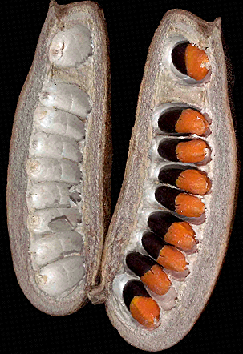
Conclusions
Millennium SeedBank project collated data on germination test conditions for 1000s of species
Now need to focus on explaining underlying relationships between conditions and germination success
Carried out the initial stage here
Now need to specialise algorithms

Slide 59
b) Fish Population Modelling

Slide 60
Data
Northern Gulf (region a)
Biomass data collected at different locations
100s of different species
From 1960s until present day
Massively complex foodwebs:
  Fish predating others, cannibalism, competing for resources, unmeasured variables

Slide 61
Results 7: Feature Selection with Bootstrap to identify “cod collapse”
Filter method using Log Likelihood
Wrapper method using BNs
Redfish

Slide 62
Results : Feature Selection
Change in Correlation of interactions between cod and high ranking species before and after 1990:

Slide 63
Fitting Dynamic Models
Learning DBNs with latent state variable
LSS = 5.0106
Fluctuation: Early Indicator of Collapse?

Slide 64
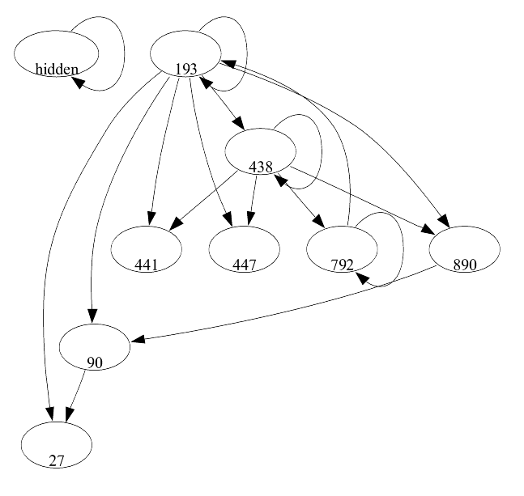
Examining DBN Net
Exploring dynamic links:
Hakes
Cod
Redfish
Haddock
Witch Flounder
White Hake
Shrimp
Thorny Skate

Slide 65
Linear Dynamic System
Instead of hidden state, continuous var:
Could be interpreted as measure of fishing? Predator population (e.g. seals)? Water temperature?
₁₉₈₇
_{(white fur ban)}
₁₉₉₁
_{1997 (white fur hunt)}
₁₉₈₄

Slide 66
Conclusions
Potential of IDA models for predicting fish biomass data
Dynamic models for capturing the complexity of foodwebs
Latent variable analysis to explore unmeasured variables (climate change, fishing, legal changes)

Slide 67
Summary
Intelligent Data Analysis
  What it is
  What it can be used for
Brief Overview of existing research
  Biological Level (Microarray)
  Medical / Clinical Level (Disease Progression)
  Population Level (Marine biomass / Seed)
What next?
  Linking the levels?
  Impact of Microbiological models in clinic?
  Impact of disease models on populations?

Slide 68
Caveats to IDA
Data Quality ✓
Spurious Correlations ✓
Over-fitting ✓
“Black Box” Modelling ✓
Over-reliance – slave to the data ?
“Can’t see the wood for the trees” ?

Slide 69

Thanks for listening!
Symposium for IDA, Porto,
Portugal: Deadline May
IDA Medicine and Pharmacology,
Bled, Slovenia: Deadline April

